Slide 1



Computer Networks Performance Evaluation

Slide 2
Chapter 12
Single Class MVA
Performance by Design:
Computer Capacity Planning by Example
Daniel A. Menascé, Virgilio A.F. Almeida, Lawrence W. Dowdy
Prentice Hall, 2004

Slide 3

Chapter 12-Outlines
12.1 Introduction
12.2 MVA Development
12.3 The MVA Algorithm
12.4 Balanced Systems
12.5 MVA Extensions and Limitations
12.6 Chapter Summary
12.7 Exercises

Slide 4
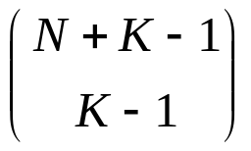
Introduction 1
The Achilles' heel of Markov models is their susceptibility to state space explosion.
In simple models, with a fixed number of identical customers, which the demands placed by each customer on each device are exponentially distributed, the number of states is given by the expression
Where N is the number of customers and K is the number of devices.

Slide 5
Introduction 2
For small systems, such as the database server example in the previous chapter with N = 2 and K = 3, the number of states is 6.
With 50 users and 50 workstations, the number of states is over 5 x 10²⁸.
Since there is one linear equation (i.e., equating flow into the state to the flow out of the state) for every state, solving such a large number of simultaneous equations is infeasible.

Slide 6
Introduction 3
However, clever algorithms have been developed for a broad class of Markov models requiring no the explicit solution to a large number of simultaneous equations.
One technique is Mean Value Analysis (MVA).
Instead of solving a set of simultaneous linear equations to find the steady state probability of being in each system state, MVA calculates the performance metrics directly for a given number of customers, knowing only the performance metrics when the number of customers is reduced by one.

Slide 7
Introduction 4
All of the N customers are assumed to be identical, forming a single class of customers. Each of the K devices is assumed to be load independent.
The demand placed on a device (the service required by a customer at a particular device) is assumed to be exponentially distributed.
There are enhancements to MVA, removing these restrictions (i.e., allowing multi-class customers, allowing load dependent servers, and allowing non-exponential service).

Slide 8
Introduction 5
This chapter is example based. In Section 12.2, the database server example from previous chapters is extended to develop the basic MVA algorithm. A concise, algorithmic description of MVA is given in Section 12.3. The special case of balanced systems is presented in Section 12.4. Section 12.5 describes extensions and limitations associated with MVA. The chapter concludes with a summary and relevant exercises.

Slide 9
Chapter 12-Outlines
12.1 Introduction
12.2 MVA Development
12.3 The MVA Algorithm
12.4 Balanced Systems
12.5 MVA Extensions and Limitations
12.6 Chapter Summary
12.7 Exercises

Slide 10
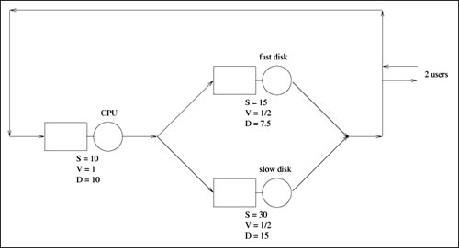
A Typical Problem
Previous Paradigm Revisited: Reconsider the database server from the previous chapter, whose diagram is reproduced in Figure 12.1.

Slide 11
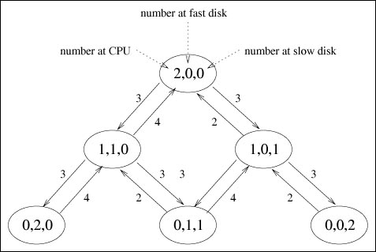
Problem Parameters
S: mean service time per visit,
V: average number of visits per transaction
D = S x V: total demand per transaction The underlying Markov model is reproduced in Figure 12.2.

Slide 12
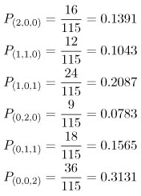
Problem Solution
By solving the six balance equations, the steady state probabilities were found to be:

Slide 13
Testing the Solution
From these probabilities, other performance metrics can be derived. For example, the average number of customers at the CPU is a simple weighted sum of those probabilities.
Therefore, the average number of customers at the CPU is:
Similarly, the average number of customers at the fast disk is:

Slide 14
Testing the Solution’
The average number of customers at the slow disk is:
The sum of these three numbers, 0.5913+0.4174+0.9913 = 2.0000, accounts for the two customers in the system.

Slide 15

CPU Utilization
The utilization of each device can be easily calculated knowing the steady state probabilities. For instance, the utilization of the CPU is:

Slide 16


Disks Utilization
Likewise, the utilization of the fast disk is:
and the utilization of the slow disk is:
[Important side note: Device utilizations are in the same ratio as their service demands, regardless of number of customers in the system (i.e., the system load).]

Slide 17
Throughputs
Knowing utilizations, device throughputs follow from the Utilization Law in Chapter 3.
Device i's throughput is given by: X_{i}= U_{i} / S_{i} .
Thus, the throughput of
  the CPU is 0.4522/10 = 0.0452 customers per second, or 2.7130 customers per minute.
  of each disk is 1.3565 customers per minute. This is consistent since the throughput of the CPU is split evenly between the two disks.

Slide 18
Residence Time
Knowing
  1) the average number of customers, n_{i}, at each device and
  2) the throughput, X_{i}, of each device,
  the response time, per visit to each device is: (via Little's Law) n_{i}/X_{i} .
  Since V=1 then the residence time= response time
Thus, the response times R_{i}
  Of the CPU is 13.08 seconds
  Of the fast disk is 18.46 seconds, and
  Of the slow disk is 43.85 seconds.

Slide 19
Transaction Response Time
A typical customer's transaction visits
  the CPU once and
  only one of the disks (with equal likelihood),
Overall response time of a transaction is a weighted sum of the individual device residence times. Thus, a transaction's response time is :
1 x 13.08 + 1/2 x 18.46 + 1/2 x 43.85 = 44.24 seconds.
A summary of the relevant performance measures is presented in Table 12.1.

Slide 20
Table 12.1. Performance Metrics for the Database Server Example (2 customers)
Average Number of Customers
CPU Fast disk Slow disk | 0.5913 0.4174 0.9913
Utilizations (%)
CPU Fast disk Slow disk | 45.22% 33.91% 67.83%
Throughputs (customers per minute)
CPU Fast disk Slow disk | 2.7130 1.3565 1.3565
Residence Times (seconds)
CPU Fast disk Slow disk | 13.08 9.23 21.93
Response Time (seconds) | 44.24

Slide 21
3 Customers in System
Consider the same database server example, with three customers. The associated Markov model is illustrated in Figure 12.3.
The ten balance equations are shown in Table 12.2.
The steady state solution to the balance equations are given in Table 12.3 and
the associated performance metrics are given in Table 12.4.
These are straight-forward extensions of the case with two customers and are left as exercises for the reader.

Slide 22
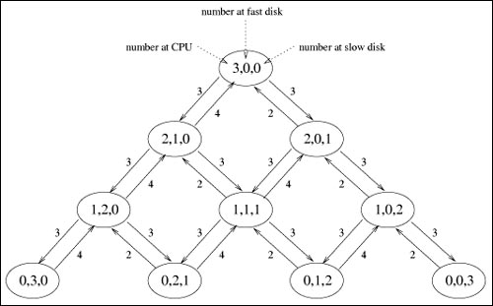
MVA Development
Figure 12.3. Markov model of the database server example (3 customers).

Slide 23
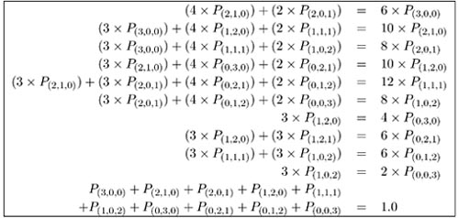
Balance Equations
Table 12.2. Balance Equations for the Database Server Example (3 customers)

Slide 24
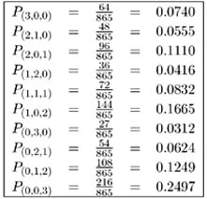
MVA Development
Table 12.3. Solution for the Database Server Example (3 customers)

Slide 25
Table 12.4. Performance Metrics for the Database Server Example (3 customers)
Average Number of Customers
CPU Fast disk Slow disk | 0.8462 0.5653 1.5885
Utilizations (%)
CPU Fast disk Slow disk | 53.18% 39.88% 79.77%
Throughputs (customers per minute)
CPU Fast disk Slow disk | 3.1908 1.5954 1.5954
Residence Times (seconds)
CPU Fast disk Slow disk | 15.91 10.63 29.87
Response Time (seconds) | 56.41

Slide 26
Side notes
As a consistency check on the performance metrics given in Table 12.4, the sum of the average number of customers at the devices equals the total number of customers in the system (i.e., three).
Also, the utilization of the CPU is (2/3) of the slow disk, and the utilization of the slow disk is twice that of the fast disk (i.e.,utilizations remain in the same ratio as their service demands).
The throughputs of the disks are identical and sum to that of the CPU.

Slide 27
Need for a New Paradigm
This technique of going from the two customer case to the three customer case (i.e., state space extension, balance equation derivation, solution of the linear equations, interpretation of the performance metrics) does not scale as the number of devices and the number of customers increases.
A new paradigm of analyzing the relationships between the performance metrics is required.

Slide 28
Arrival Theorem: Example
Consider the relationship between the residence time at the CPU with three customers (i.e., 15.91 seconds) to the average number of customers at the CPU with two customers (i.e., 0.5913).
Three customers in the network:
  at the instant when a customer arrives at the CPU, the average number of customers that the arriving customer sees already at the CPU is precisely the average number of customers at the CPU with two customers in the network. (This is an important result known as the "Arrival Theorem".)
  Therefore, an arriving customer at the CPU will expect to see 0.5913 customers already there.

Slide 29
Arrival Theorem: Example’
Thus, the time it will take for the newly arriving customer to complete service and leave the CPU (i.e., its residence time) will be
  the time it takes to service those customers already at the CPU
  plus the time it takes to service the arriving customer.
Since the average service time per customer at the CPU is 10 seconds,
  it will take an average of 10 x 0.5913 seconds to service those customers already at the CPU,
  plus an additional 10 seconds to service the arriving customer.
  Therefore, the residence time is 10(1+0.5913) = 15.91 seconds.

Slide 30


Arrival Theorem
As a general relationship, Letting
R_{i} (n) be the average response time per visit to device i when there are n customers in the network, and
S_{i} be the average service time of a customer at device i, and
be the average number of customers at device i when there are a total of n–1 customers in system,
the following relationship exists:

Slide 31
Arrival Theorem: Example’’
Response time at the fast disk, when there are three customers in the network, is the product of its service time (i.e., 15 seconds) and the number of customers at the disk: 15(1 + 0.4174) = 21.36 seconds.
Likewise, the residence time at the slow disk is : 30(1 + 0.9913) = 59.74 seconds.

Slide 32


Overall Response Time
Now the overall response time, R₀(n), is the sum of the residence times (i.e. ).
In database server with three customers, the residence times at CPU, fast disk, and slow disk are 15.91, 21.26,and 59.74 seconds.
The number of visits to these devices per transaction is 1.0, 0.5, and 0.5.
Thus the overall response time is (1.0 x 15.91) + (0.5 x 21.26) + (0.5 x 59.74) = 56.41 seconds.
Overall Response Time Formula:

Slide 33


System Throughput
From Little's Law ,the average number of customers in the system ,n, is the product of system throughput, X₀(n), and system response time, R₀ (n) .Thus,
The individual device throughputs can be found using the Forced Flow Law,

Slide 34
Utilization
The device utilizations follow from the device throughputs via the Utilization Law,

Slide 35
Customer Number
finally average number of customers at each device when there are n customers in the system follows directly from Little's Law applied to each individual device,
But, from the Forced Flow Law,
X_{i}(n) = V_{i} x X₀(n). Thus,

Slide 36
Example
In the database server with three customers, overall system throughput is
X₀ (3) = 3/R(3) = 3/56.41 = 0.0532 customers/second (3.1908 customers/minute) which yields 0.8462 customers.
And the individual device throughputs are 0.0532, 0.0266, and 0.0266 customers per seconds.
Average number of customers at the fast disk when there are three customers in the system is 0.0266x21.26 = 0.5653 customers. At the slow disk, there are 0.0266 x 59.74 = 1.5885 customers.

Slide 37
A Conclusion
Knowing only the average number of customers at each device with two customers, the device residence times when there are three customers in the network can be quickly derived.
Knowing these residence times leads directly to the overall response time.
The initialization of the iterative process is resolved by noting that when no customers are in system, the average number of customers at each device is zero.
Thus, when for all devices i.

Slide 38
A Conclusion’
Given the average number of customers at each device with n – 1 customers in the system, the device residence times when there are n customers in the network can be derived.
Knowing these residence times leads to the overall response time, which, in turn, leads to the system and individual device throughputs.
The device throughputs lead to
  the device utilizations and to
  the average number of customers at each device with n customers in the system.
Knowing these, the iteration continues to derive the performance metrics with n + 1 customers in the system, and, in general, to any desired number of customers ... all without formulating and solving any of the underlying steady state balance equations.

Slide 39
Chapter 12-Outlines
12.1 Introduction
12.2 MVA Development
12.3 The MVA Algorithm
12.4 Balanced Systems
12.5 MVA Extensions and Limitations
12.6 Chapter Summary
12.7 Exercises

Slide 40
The MVA Algorithm
The MVA algorithm is given concisely in Table 12.5 for any single class network with N customers and K devices. The average service time of a customer at device i is S_{i} and the average number of visits that a customer makes to device i is V_{i}.
For all customer populations n (1 ≤ n ≤ N), the algorithm finds the following performance metrics:
  the average residence time at each device,
  the overall system response time,
  the overall system throughput,
  the individual device throughputs,
  the device utilizations, and
  the average number of customers at each device.

Slide 41

Table 12.5. The MVA Algorithm
Initialize the average number of customers at each device i:
For each customer population n = 1, 2,... N,
Calculate the average residence time for each device i:
Calculate the overall system response time:
Calculate the overall system throughput:
Calculate the throughput for each device i:
X_{i}(n) = V_{i} x X₀(n)
Calculate the utilization for each device i:
U_{i}(n) = S_{i} x X_{i}(n)
Calculate the average number of customers at each device i:

Slide 42


Example
Applied to the database server example, where the average service times are 10 seconds, 15 seconds, and 30 seconds, respectively, for the CPU (cp), fast disk (fd), and slow disk (sd), and where the average number of visits to each device are 1.0, 0.5, and 0.5, the MVA iteration proceeds as follows:
Initialize the average number of customers at each device i:

Slide 43


Example n=1
For customer population n = 1, calculate the average residence time for each device i:
Calculate the overall system response time:
Calculate the overall system throughput:

Slide 44




Example n=1’
Calculate the throughput for each device i:
( X_{i}(n) = V_{i} x X₀(n) ).
Calculate the utilization for each device i:
( U_{i} (n) = S_{i} x X_{i} (n) ).
Calculate the average number of customers at each device i:

Slide 45


Example n=2
For customer population n = 2, calculate the average residence time for each device i:
Calculate the overall system response time:
Calculate the overall system throughput:

Slide 46



Example n=2’
Calculate the throughput for each device i:
( X_{i}(n) = V_{i} x X₀(n) ).
Calculate the utilization for each device i:
( U_{i} (n) = S_{i} x X_{i} (n) ).
Calculate the average number of customers at each device i:

Slide 47


Example n=3
For customer population n = 3, calculate the average residence time for each device i:
Calculate the overall system response time:
Calculate the overall system throughput:

Slide 48



Example n=3’
Calculate the throughput for each device i:
( X_{i}(n) = V_{i} x X₀(n) ).
Calculate the utilization for each device i:
( U_{i} (n) = S_{i} x X_{i} (n) ).
Calculate the average number of customers at each device i:

Slide 49
Example Conclusion
These performance metrics found via MVA for two and three customers (i.e., when n = 2 and when n = 3) correspond directly to those found from first principles (i.e., by constructing the Markov model, forming the balance equations, solving the balance equations, and interpreting the results)

Slide 50
Chapter 12-Outlines
12.1 Introduction
12.2 MVA Development
12.3 The MVA Algorithm
12.4 Balanced Systems
12.5 MVA Extensions and Limitations
12.6 Chapter Summary
12.7 Exercises

Slide 51
Balanced Systems
The MVA iteration starts once the customer distribution among the devices is known. That is, knowing how n – 1 customers are distributed among the devices, the performance measures when there are n customers in the system follow directly, as seen from the MVA algorithm given in Table 12.5.
Now consider a balanced system. A system is considered to be balanced if a typical customer places the same average Demand (D) on each of the devices. This implies that all devices are equally utilized.

Slide 52
Performance Upper Band
A balanced system is not one where all devices are the same speed, only that the faster devices are either visited more often or the demand per visit to them is higher.
A balanced system implies that there is no single bottleneck in the system.
Balanced systems are important to consider, since they provide an upper bound on performance, a gold standard toward which to aspire.

Slide 53
Example
For example, reconsider the database server example. From Tables 12.1 and 12.4 , the slow disk has the highest utilization and is the bottleneck .So the system is not balanced.
Because the slow disk is over-utilized compared to the other devices, one way to improve performance would be to move some of the files from the slow disk to the fast disk. This has the effect of reducing the load (and utilization) of the slow disk and increasing the load (and utilization) of the fast disk.

Slide 54
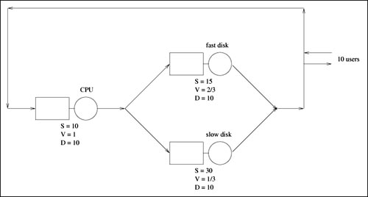
Example’
By moving disk files so that the fast disk is visited twice as often as the slow disk, the overall system becomes balanced. Now consider this balanced system with 10 customers in the system, as shown in Figure 12.4. All device demands (D's) are equal.
Instead of running 10 iterations of MVA, because the system is balanced, only one MVA step is required;

Slide 55
One Iteration
Recall that the only thing necessary (the iteration basis) for finding the performance measures for 10 customers is for MVA to know the average number of customers at each device when there are only 9 customers in the system (ñ_{i}(9) for each device i).
Since the system is balanced, the 9 customers are equally distributed among devices with 3 customers being at each of the 3 devices.
Knowing that ñ_{i}(9) = 3 for each i, from the MVA algorithm in Table 12.5, it follows that the average residence time for each device i is :

Slide 56


Calculations
The overall system response time is:
The overall system throughput is:

Slide 57
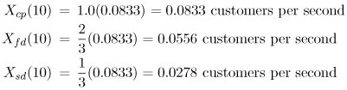

Calculations’
The throughput for each device i (X_{i} (n) = V_{i} x X₀(n)) is:
The utilization for each device i (U_{i} (n) = S_{i} x X_{i} (n)) is:

Slide 58

Calculations’’
Finally, the average number of customers at each device i ( ) is:

Slide 59
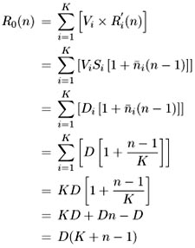
Balanced Calculation
In balanced systems, all the device demands (D_{i}'s) are equivalent. Let this common device demand be D. Therefore, finding the overall system response time can be simplified to:

Slide 60

Balanced System Equation
Overall system throughput is simply:
As a verification in the balanced database server example, where n = 10, D = 10, and K = 3,
the overall system response time is R₀(10) = 10(3 + 10 – 1) = 120 seconds and the overall system throughput is
X₀ (10) = 10/120 = 0.0833 customers/second.

Slide 61
Chapter 12-Outlines
12.1 Introduction
12.2 MVA Development
12.3 The MVA Algorithm
12.4 Balanced Systems
12.5 MVA Extensions and Limitations
12.6 Chapter Summary
12.7 Exercises

Slide 62
MVA Extensions and Limitations
MVA algorithm has been the focus of much researchs. These include:
Multi-class networks
Networks with load dependent servers
Networks with open and closed classes of customers
The extension of MVA to product form, load-independent, multi-class networks is the topic of Chapter 13 . Chapter 14 extends MVA and the treatment of multiclass open QNs to the load-dependent case. Approximations to deal with non-product form QNs are presented in Chapter 15.

Slide 63
limitations and shortcomings surrounding MVA
MVA does not provide the steady state probabilities of individual system states.
MVA does not provide transient analysis information.
MVA does not model state dependent behavior.
MVA solves product form networks. As a result, MVA is not directly applicable to non-product form situations.

Slide 64
Chapter 12-Outlines
12.1 Introduction
12.2 MVA Development
12.3 The MVA Algorithm
12.4 Balanced Systems
12.5 MVA Extensions and Limitations
12.6 Chapter Summary
12.7 Exercises

Slide 65
Chapter Summary
The Mean Value Analysis technique is arguably one of the most significant contributions to the field of performance evaluation within the past 25 years. It is the primary solution engine behind the large majority of state-of-the-art analytical solution packages currently in use. MVA is intuitive, elegant, and simple.
This chapter first motivates, then develops, then summarizes, then applies, and finally qualifies MVA. Examples from the database server example introduced in previous chapters are used to demonstrate MVA. The following exercises are intended to reinforce and to broaden the reader's understanding and range of applicability of MVA.

